Slide 1

CAR LAUNCH ANALYSIS – UK MARKET
Presented By
Guneet Singh Panesar (prepic10039)

Slide 2
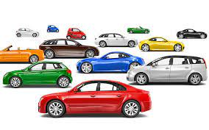
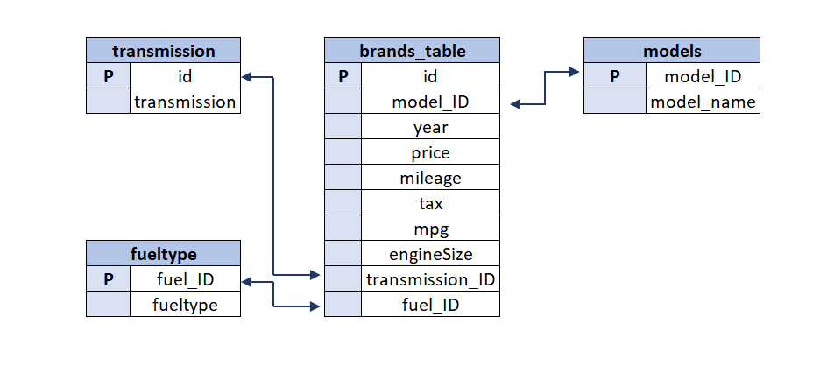
DATA OVERVIEW

Slide 3
POINTS OF ANALYSIS
Classification of customers based on different income classes and the average income per income class.
Number of Customers who purchased the Cars in each income class.
The overall trend in number of vehicles sold over the years from 1970 till 2020.
Number of cars in each Price Bucket sold over the years and variation in them.
Change in price of each model over the years and related trends.
Change in number of Cars sold for each model over the years and related trends.
Segmentation of Cars based on their transmission.
Detailed Vehicle metrics for each purchase.

Slide 4
POINTS OF ANALYSIS
Most selling vehicles based on fuel efficiency.
Most selling vehicles based on their prices.
Overall highest selling vehicle and analysis.
Which transmission type provides better fuel economy?

Slide 5
OVERVIEW AND INTRODUCTION
This analysis is based only on customers who purchased a car from the available models between the years 1970 and 2020 (inclusive).
The average per capita income of people in UK is about $47,620.
Considering this, the whole observation is bucketed into 5 sub-income groups.
Also considered during the analysis is the fact that a family won’t spend all of their total income in purchasing a car.
Secondly, the cars also are bucketed into 5 sub-buckets of almost equal sizes depicting the most to least expensive.
The main objective is to clarify which car segment is most preferred and what are the possible reasons behind the same.
Also, what all conclusions can be drawn from the whole data to predict the market trend for the upcoming years.

Slide 6
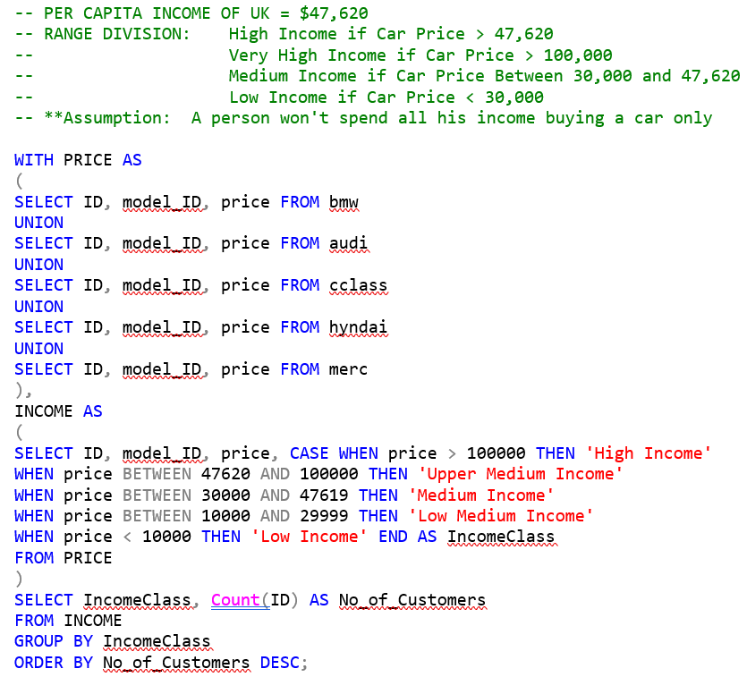
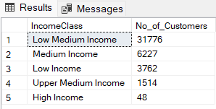
Finding Income CLASS BASED on GDP $ prices

Slide 7
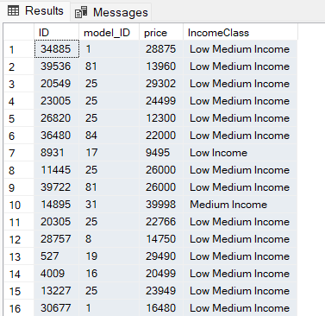
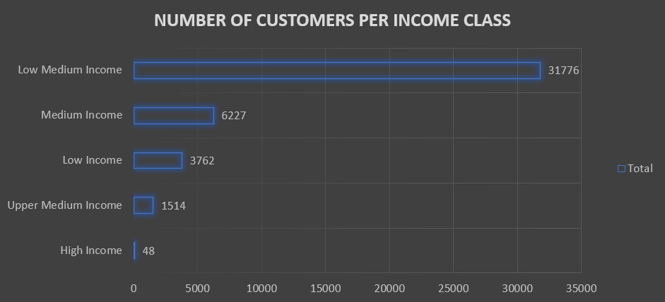
SEGRIGATION OF CUSTOMERS BASED ON INCOME CLASS
Graphical representation of Class Division

Slide 8
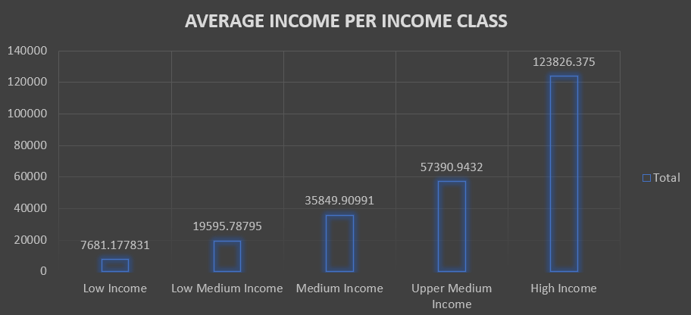
AVERAGE INCOME PER INCOME CLASS
The inferences that can be drawn here are that most of the customers belong to the Low Medium Income class wherein the average expense on cars that they can afford is about $20,000.
Also, there is a very meager section of people with High Income but the average price that they could afford for a car is significantly higher at about $124,000.

Slide 9
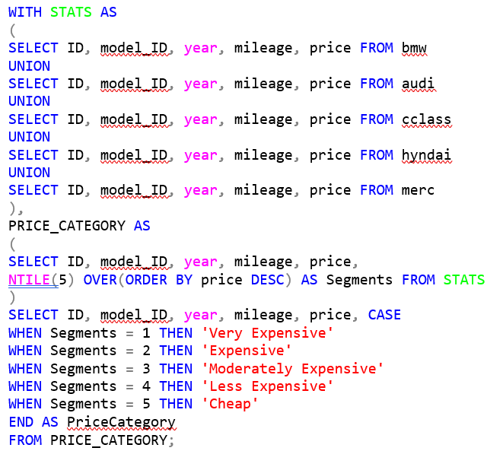
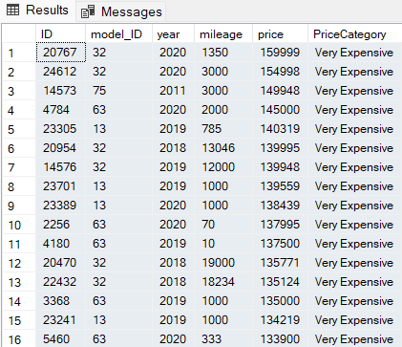
CATEGORIZATION of CARS BASED ON THEIR PRICES

Slide 10
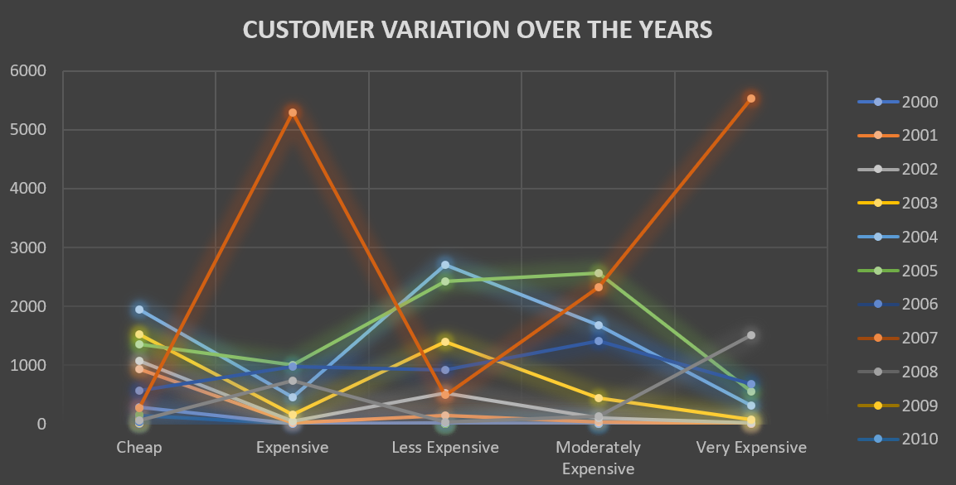
EXPENSE WISE CAR SALES OVER THE YERAS
Here, it can be observed that over the years the Less Expensive and Moderately Expensive car segments have a pretty constant sales and also the same can be said for Cheap one. Also, the Expensive and Very Expensive segments have lesser sales throughout.
The year 2019 portrays just the opposite trend, clearly indicating that there was a financial boom in the market during the period.

Slide 11
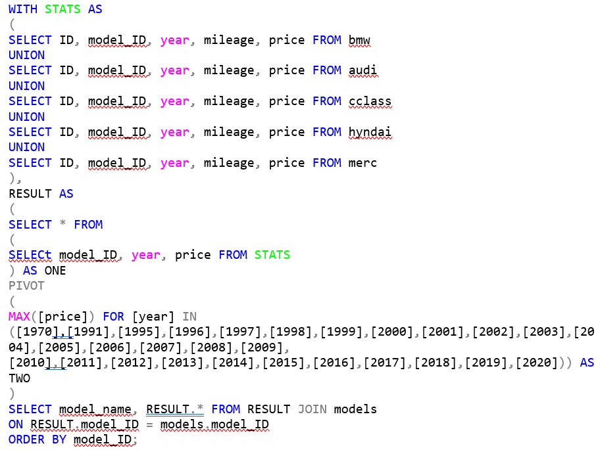
Price variation across different models over the years
The common trend observed here, as shown in the next slide, is that the majority of vehicle sales began from the year 2010.
Throughout the tenure of sales of these cars, the prices just kept steadily increasing over the previous year. The reason simply being that newer variants offer much more features. Plus, the older models become rarer with time, hence, their values increase.

Slide 12
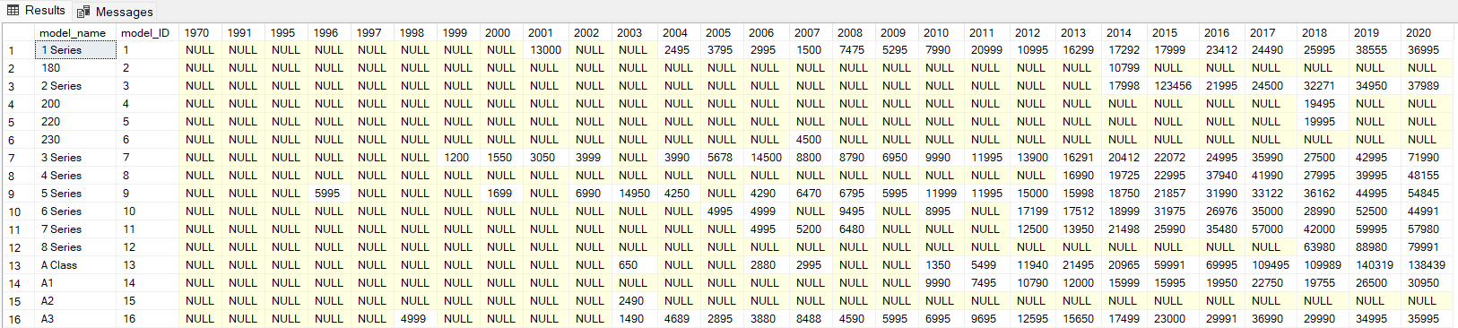
PRICE CHANGES over YEARS
The trends in this chart are explained in the previous slide. More models introduced in later years and also there is a steady increase in their price over time.

Slide 13
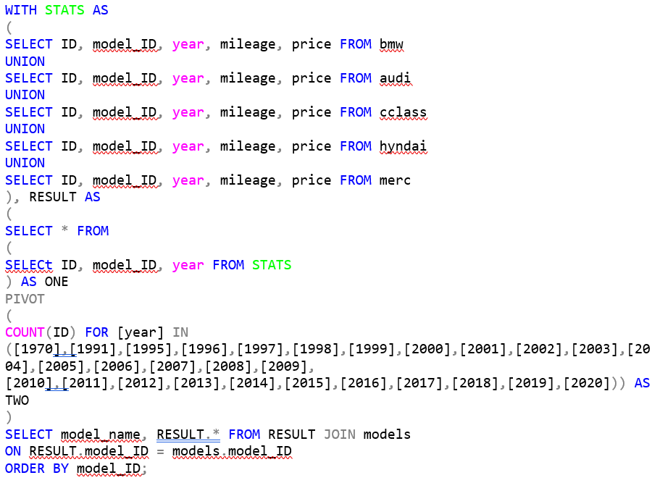
Number of units sold for each car model (Year wise)
Similar to the previous trend, a larger number of vehicles started getting sold after the year 2010. Plus, a significant rise in number of car models have been seen over time.
Customers are getting more options to choose from and hence the market is equally distributed over all price ranges as the time progresses.
The Moderately Expensive car segment has comparatively more customers than others.
Trend can be seen in the chart on next slide.

Slide 14
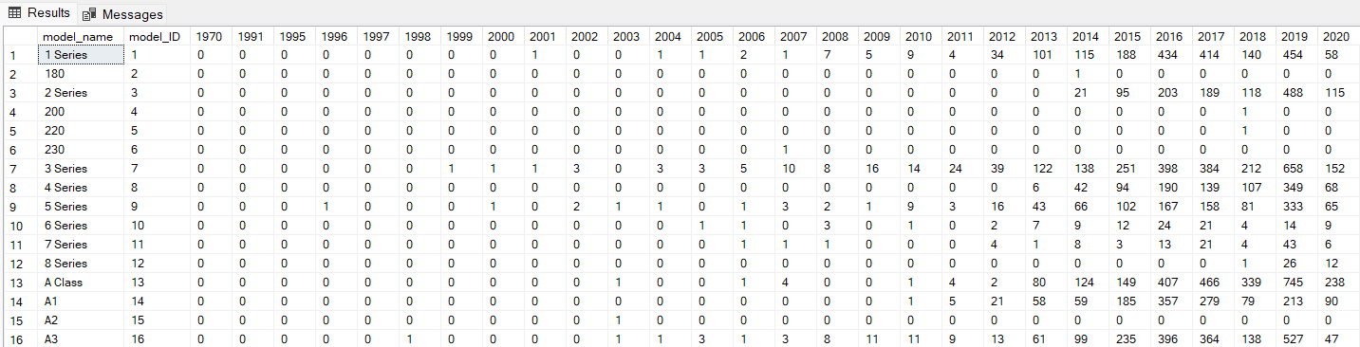
Number of units sold for each car model (Year wise)
This chart is comparable to the previous chart. So the number of models sold for each price tag can be compared.

Slide 15
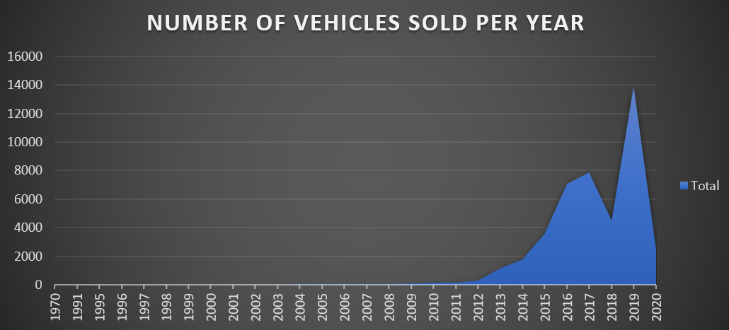
Number of units sold for each car model (Year wise)
Graphical Representation of yearly sales for all car models. Number of vehicles sold increase steadily after 2010 and a sharp peak can be seen in year 2019 due to market boom.

Slide 16
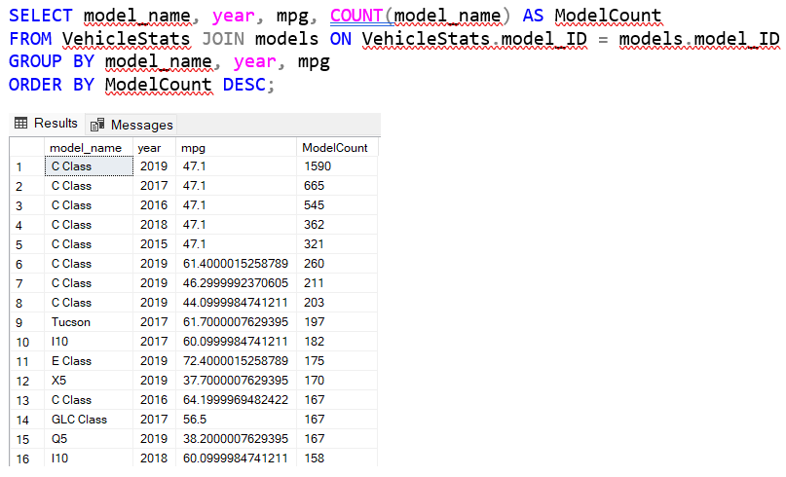
Car model sales based on fuel economy, price and overall best
For the case of most selling car model based on fuel economy, the C Class has the most number of sale counts.
This data is segregated for the models of each year and also varying fuel consumption (if any).

Slide 17
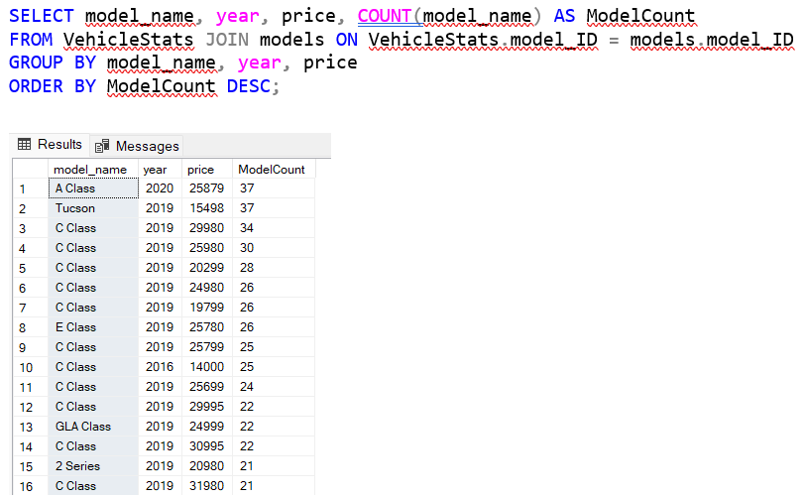
Car model sales based on fuel economy, price and overall best
For inferences of various car model sales based on price, we can see that the most selling car is again the C Class with a price bracket varying from low $20,000s to high $30,000s.
This is the same price bracket corresponding to Low Medium Income class of buyers. And we can clearly see from the list the almost all of these vehicles fall under the same price bracket.
So our inferences about the income class are correct.

Slide 18
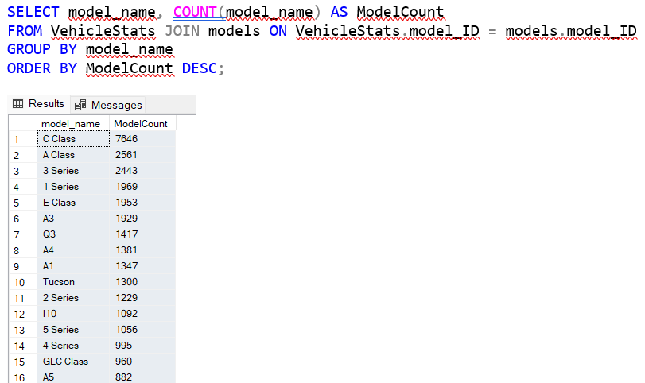
Car model sales based on fuel economy, price and overall best
The overall best selling car as expected is the Mercedes C Class.
The obvious reasons behind this being the quite good fuel economy of the car along with a moderate price tag.
Also the availability of this car model across various years adds to the consistency and confidence of customers in the company and this particular model.
Due to this 3 out of the top 5 car models to be sold are from Mercedes.

Slide 19
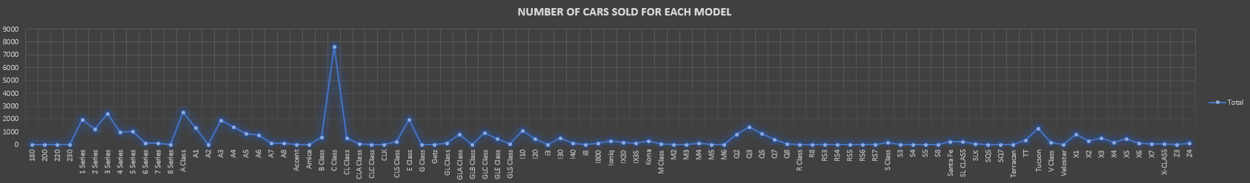
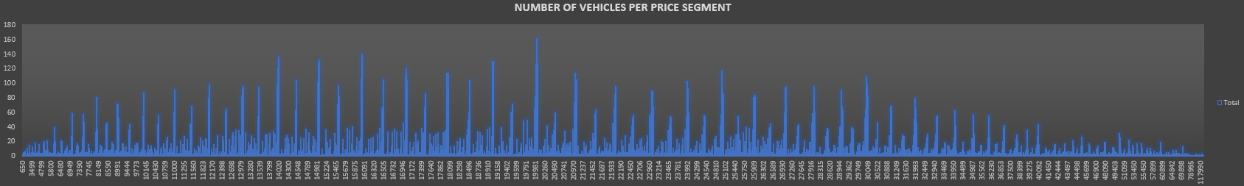
Car model sales based on fuel economy, price and overall best
Graphical Inferences based on previous 3 slides.

Slide 20
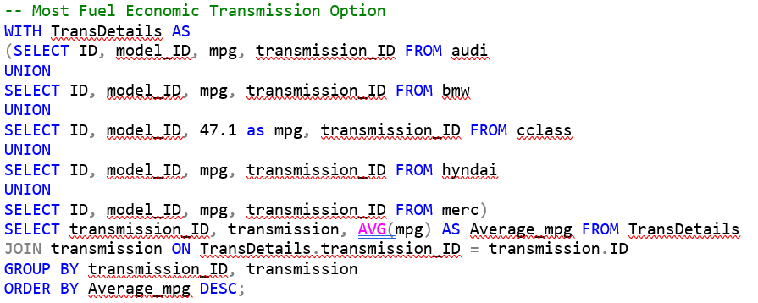
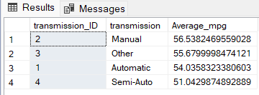
RELATION BETWEEN TRANSMISSION TYPE AND FUEL ECONOMY

Slide 21
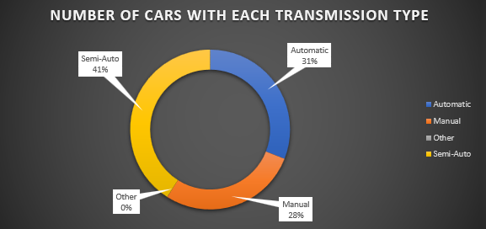
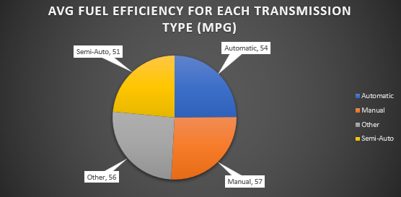
RELATION BETWEEN TRANSMISSION TYPE AND FUEL ECONOMY
Most of the cars are semi automatic, followed by automatic and then finally manual.
Alongside, the average fuel consumption of semi automatic is around 51 mpg, automatic has a slightly higher fuel economy at 54 mpg and manual has the highest among these three at 57 mpg.
The verdict being that semi automatic having both, the adaptability of automatic and control of manual whenever needed with an addition of pretty similar milage like the others has a upper hand.

Slide 22
CONCLUSION & ENDING
The complete analysis has been done and inferences are drawn based on various cue points in the respective segments of their topics.
The most preferred car brand along with the model were analysed on it’s price, value, fuel economy and how it stands alongside it’s competitors.
The income class and affordability was successfully predicted.
The average car market trends were analysed based on the given data and valuable insights were drawn.
Thankyou !

